Slide 1
X-section R-Q
See Cross section locations.kmz & Cross section labels.kmz for location in Google Earth

Slide 2
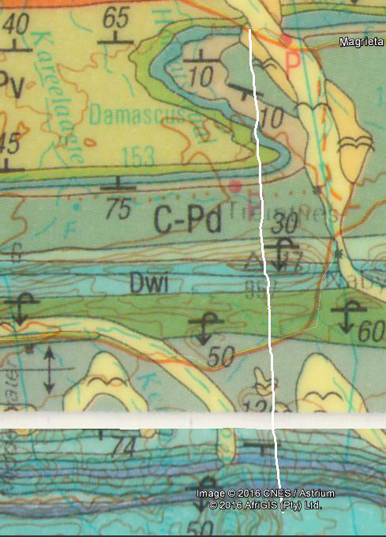

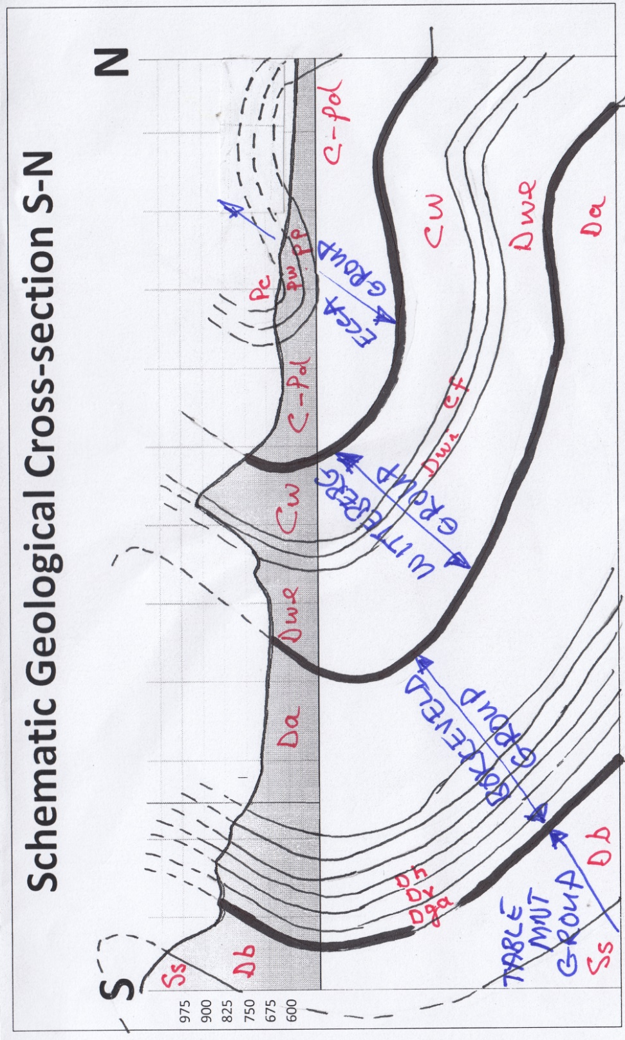
Pv
Q
Pc
Pw
Q
Pp
N
C-Pd
C-Pd
3320 Ladismith 1:250 000 Geology
Pw
Pp
Q
Pv
Pc
C-Pd
Cw
Schematic Geologic Cross Section R-Q
Cf
Dwi
Dwe
Dwa
Da
Dkl
Dw
Dbo
Dh
Dt
Dt
Dv
Dh
Dga
Dga
Dv
Dg
Db
R
Ss
R

